Slide 1



Ecommerce Dashboard
View in Power BI
Last data refresh:
5/12/2024 8:50:05 AM UTC
Downloaded at:
5/12/2024 8:51:27 AM UTC

Slide 2
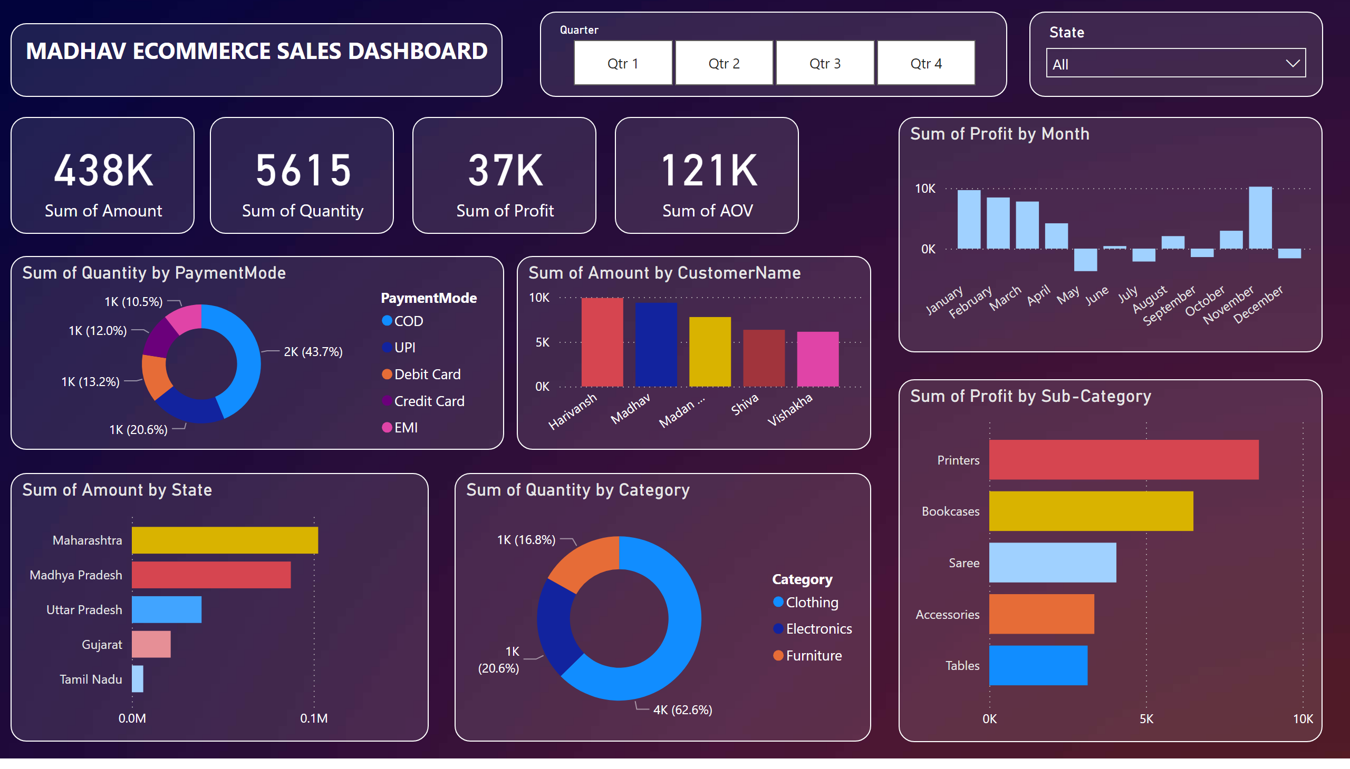
Page 1
Notes:
textbox
No alt text provided
columnChart
No alt text provided
barChart
No alt text provided
donutChart
No alt text provided
donutChart
No alt text provided
card
No alt text provided
card
No alt text provided
card
No alt text provided
card
No alt text provided
barChart
No alt text provided
columnChart
No alt text provided
slicer
No alt text provided
slicer
No alt text provided

